Slide 1
Unit 2

Slide 2
Problem-solving agent
Problem-solving agent
A kind of goal-based agent
It solves problem by
finding sequences of actions that lead to desirable states (goals)
To solve a problem,
the first step is the goal formulation, based on the current situation

Slide 3
Building goal-based agents
To build a goal-based agent we need to answer the following questions:
What is the goal to be achieved?
What are the actions?
What is the representation?
E.g., what relevant information is necessary to encode in order to describe the state of the world, describe the available transitions, and solve the problem?)
Initial
state
Actions
Goal
state

Slide 4
Search
Because there are many ways to achieve the same goal
Those ways are together expressed as a tree
Multiple options of unknown value at a point,
the agent can examine different possible sequences of actions, and choose the best
This process of looking for the best sequence is called search
The best sequence is then a list of actions, called solution

Slide 5
Search algorithm
Defined as
taking a problem
and returns a solution
Once a solution is found
the agent follows the solution
and carries out the list of actions – execution phase
Design of an agent
“Formulate, search, execute”

Slide 6
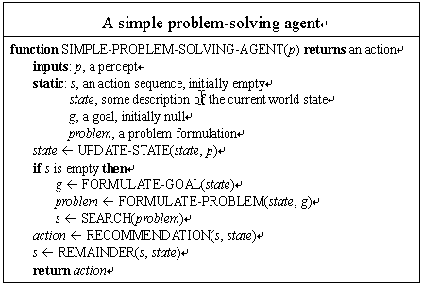

Slide 7
Well-defined problems and solutions
A problem is defined by 5 components:
Initial state
Actions
Transition model or
(Successor functions)
Goal Test.
Path Cost.

Slide 8
Well-defined problems and solutions
A problem is defined by 4 components:
The initial state
that the agent starts in
The set of possible actions
Transition model: description of what each action does.
(successor functions): refer to any state reachable from given state by a single action
Initial state, actions and Transition model define the state space
the set of all states reachable from the initial state by any sequence of actions.
A path in the state space:
any sequence of states connected by a sequence of actions.

Slide 9
Well-defined problems and solutions
The goal test
Applied to the current state to test
if the agent is in its goal
-Sometimes there is an explicit set of possible goal states. (example: in Amman).
-Sometimes the goal is described by the properties
instead of stating explicitly the set of states
Example: Chess
the agent wins if it can capture the KING of the opponent on next move ( checkmate).
no matter what the opponent does

Slide 10
Well-defined problems and solutions
Together a problem is defined by
Initial state
Actions
Successor function
Goal test
Path cost function
The solution of a problem is then
a path from the initial state to a state satisfying the goal test
Optimal solution
the solution with lowest path cost among all solutions

Slide 11
Example: Travelling in Romania
Scenario
On holiday in Romania; currently in Arad Flight leaves tomorrow from Bucharest
B. Beckert: Einführung in die KI / KI für IM – p.4

Slide 12
Example: Travelling in Romania
Oradea
Neamt
Zerind
Iasi
Arad
Sibiu
Fagaras
Vaslui
Timisoara
Rimnicu Vilcea
Lugoj
Pitesti
Hirsova
Mehadia
Urziceni
Bucharest
Dobreta
Craiova
Eforie
Giurgiu

Slide 13
Example: Travelling in Romania
Scenario
On holiday in Romania; currently in Arad Flight leaves tomorrow from Bucharest
Goal
Be in Bucharest

Slide 14
Example: Travelling in Romania
Scenario
On holiday in Romania; currently in Arad Flight leaves tomorrow from Bucharest
Goal
Be in Bucharest
Formulate problem
States: various cities
Actions: drive between cities

Slide 15
Example: Travelling in Romania
Scenario
On holiday in Romania; currently in Arad Flight leaves tomorrow from Bucharest
Goal
Be in Bucharest
Formulate problem
States: various cities
Actions: drive between cities
Solution
Appropriate sequence of cities
e.g.: Arad, Sibiu, Fagaras, Bucharest

Slide 16
Problem types
Single-state problem
observable
deterministic
static
discrete
(at least the initial state)
Multiple-state problem
partially observable
deterministic
static
discrete
(initial state not observable)
Contingency problem
partially observable
non-deterministic
(initial state not observable)

Slide 17
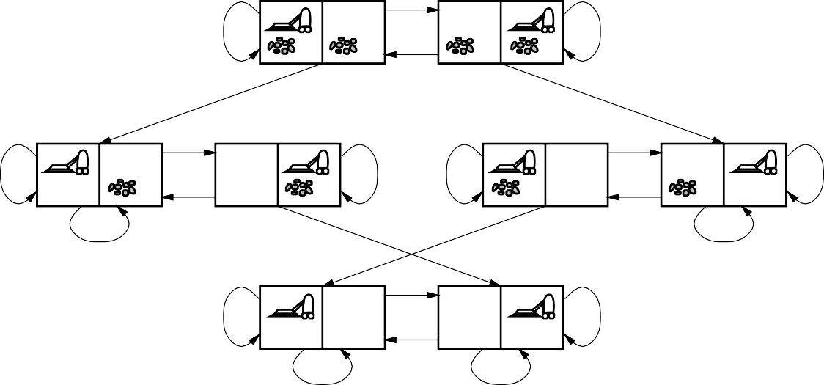
Example: Vacuum-cleaner
L
R
R
L
S
S
L
R
R
L
R
R
L
L
S
S
S
S
L
R
R
L
S
S
States
Actions Goal test Path cost
B. Beckert: Einführung in die KI / KI für IM – p.13

Slide 18
Example: Vacuum-cleaner
L
R
R
L
S
S
L
R
R
L
R
R
L
L
S
S
S
S
L
R
R
L
S
S
States
integer dirt and robot locations
Actions
left, right, suck, noOp
Goal test
not dirty ?
Path cost
1 per operation
(0 for noOp)
B. Beckert: Einführung in die KI / KI für IM – p.13

Slide 19
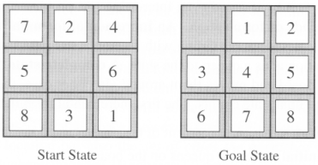
The 8-puzzle

Slide 20
The 8-puzzle
States:
a state description specifies the location of each of the eight tiles and blank in one of the nine squares
Initial State:
Any state in state space
Successor function:
the blank moves Left, Right, Up, or Down
Goal test:
current state matches the goal configuration
Path cost:
each step costs 1, so the path cost is just the length of the path

Slide 21

Tree search algorithms
Offline
Simulated exploration of state space in a search tree by generating successors of already-explored states
function TREE-SEARCH( problem, strategy) returns a solution or failure initialize the search tree using the initial state of problem
loop do
if there are no candidates for expansion then return failure choose a leaf node for expansion according to strategy
if the node contains a goal state then return the corresponding solution
else
expand the node and add the resulting nodes to the search tree
end

Slide 22
Tree search: Example
Arad
Sibiu
Timisoara
Zerind
Arad
Fagaras
Oradea
Rimnicu Vilcea
Arad
Lugoj
Arad
Oradea
B. Beckert: Einführung in die KI / KI für IM – p.16

Slide 23
Tree search: Example
Arad
Sibiu
Timisoara
Zerind
Arad
Fagaras
Oradea
Rimnicu Vilcea
Arad
Lugoj
Arad
Oradea
B. Beckert: Einführung in die KI / KI für IM – p.16

Slide 24
Tree search: Example
Arad
Sibiu
Timisoara
Zerind
Arad
Fagaras
Oradea
Rimnicu Vilcea
Arad
Lugoj
Arad
Oradea
B. Beckert: Einführung in die KI / KI für IM – p.16

Slide 25
Implementation: States vs. nodes
State
A (representation of) a physical configuration
Node
A data structure constituting part of a search tree (includes parent, children, depth, path cost, etc.)
parent
State
5 | 4
6 | 1 | 8
7 | 3 | 2
Node
depth = 6
g = 6
5
4
6
1
8
state
children
7
3
2

Slide 26
Implementation of search algorithms
function TREE-SEARCH( problem, fringe) returns a solution or failure
fringe ← INSERT(MAKE-NODE(INITIAL-STATE[problem]),fringe)
loop do
if fringe is empty then return failure
node ← REMOVE-FIRST(fringe)
if GOAL-TEST[problem] applied to STATE(node) succeeds then return node
else
fringe ← INSERT-ALL(EXPAND(node, problem), fringe)
end
fringe State Expand
queue of nodes not yet considered
gives the state that is represented by node
creates new nodes by applying possible actions to node

Slide 27
Search strategies
Strategy
Defines the order of node expansion
Important properties of strategies
completeness time complexity space complexity optimality
does it always find a solution if one exists? number of nodes generated/expanded maximum number of nodes in memory does it always find a least-cost solution?
Time and space complexity measured in terms of
b maximum branching factor of the search tree
d depth of a solution with minimal distance to root
m maximum depth of the state space (may be ∞)

Slide 28
Searching for solutions
Finding out a solution is done by
searching through the state space
All problems are transformed
as a search tree
generated by the initial state and successor function

Slide 29
Search tree
Initial state
The root of the search tree is a search node
Expanding
applying successor function to the current state
thereby generating a new set of states
leaf nodes
the states having no successors
Fringe : Set of search nodes that have not been expanded yet.
Refer to next figure

Slide 30
Search tree
The essence of searching
in case the first choice is not correct
choosing one option and keep others for later inspection
Hence we have the search strategy
which determines the choice of which state to expand
good choice → fewer work → faster
Important:
state space ≠ search tree

Slide 31
Search tree
A node is having five components:
STATE: which state it is in the state space
PARENT-NODE: from which node it is generated
ACTION: which action applied to its parent-node to generate it
PATH-COST: the cost, g(n), from initial state to the node n itself
DEPTH: number of steps along the path from the initial state

Slide 32
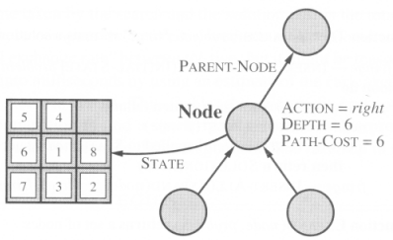

Slide 33
Measuring problem-solving performance
The evaluation of a search strategy
Completeness:
is the strategy guaranteed to find a solution when there is one?
Optimality:
does the strategy find the highest-quality solution when there are several different solutions?
Time complexity:
how long does it take to find a solution?
Space complexity:
how much memory is needed to perform the search?

Slide 34
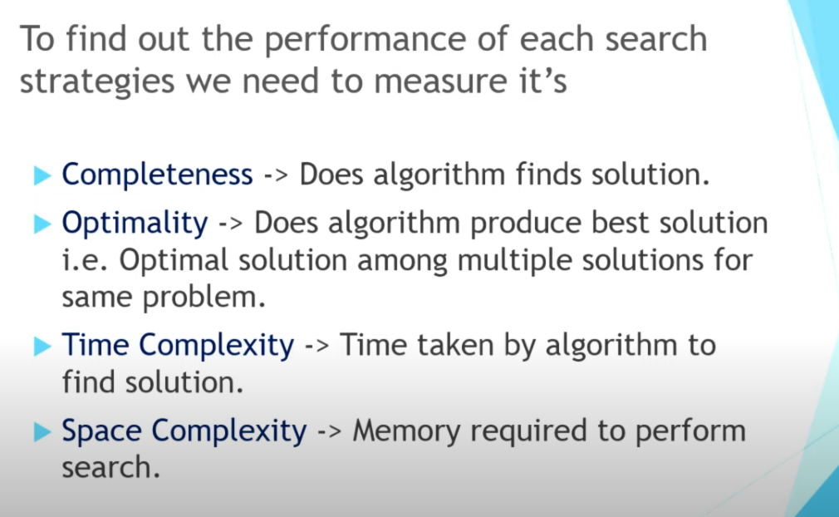

Slide 35
Measuring problem-solving performance
In AI, complexity is expressed in
b, branching factor, maximum number of successors of any node
d, the depth of the shallowest goal node.
(depth of the least-cost solution)
m, the maximum length of any path in the state space
Time and Space is measured in
number of nodes generated during the search
maximum number of nodes stored in memory

Slide 36
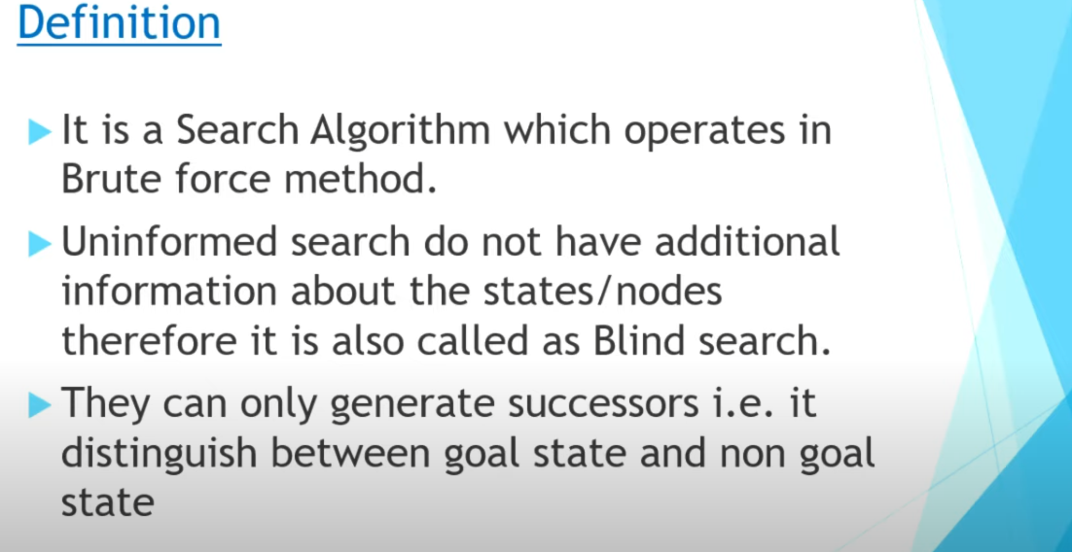
Uninformed search

Slide 37
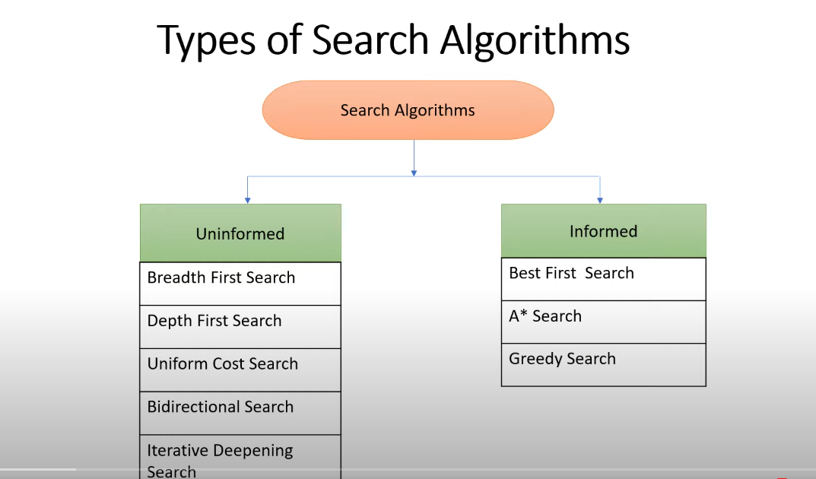

Slide 38
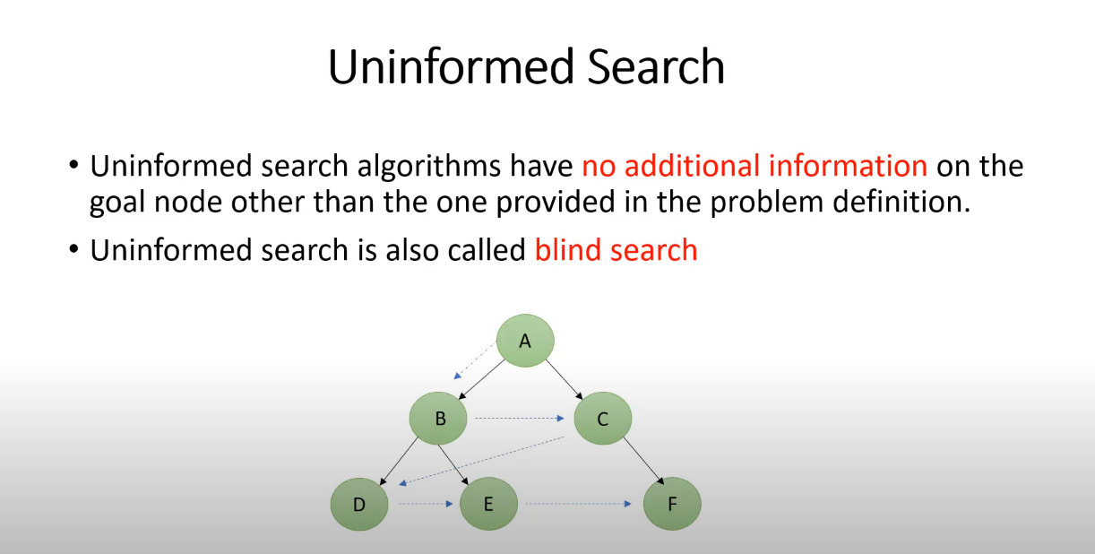

Slide 39
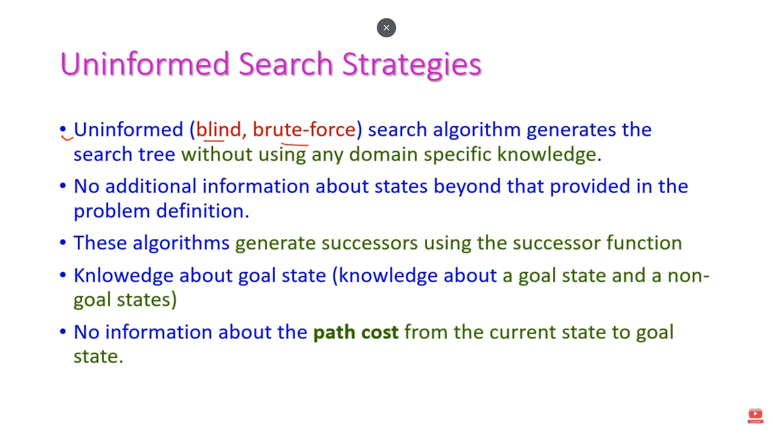

Slide 40
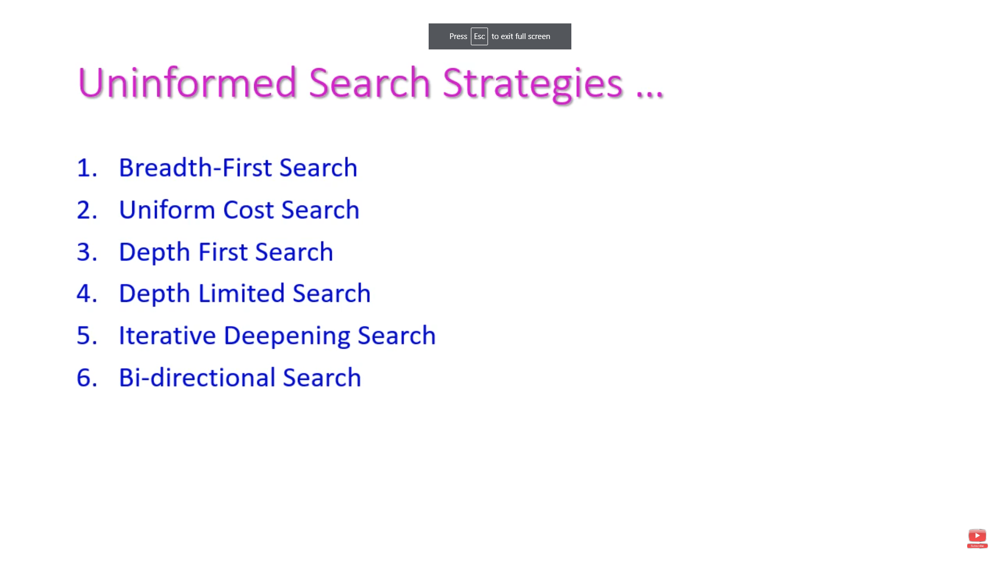

Slide 41
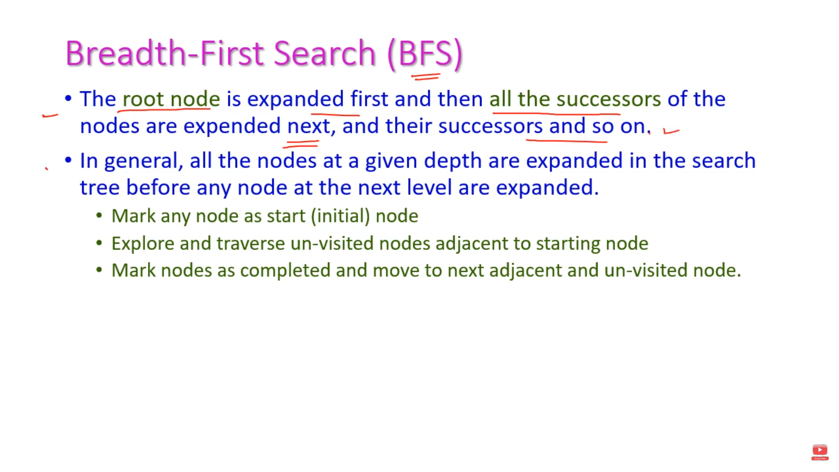

Slide 42
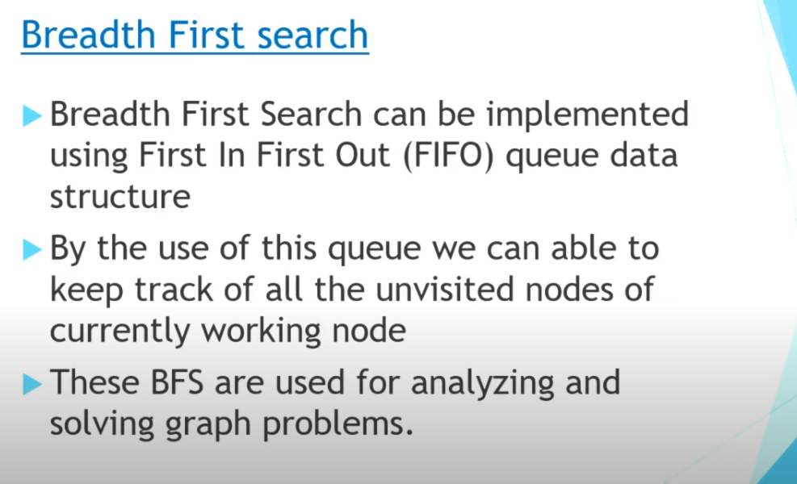

Slide 43
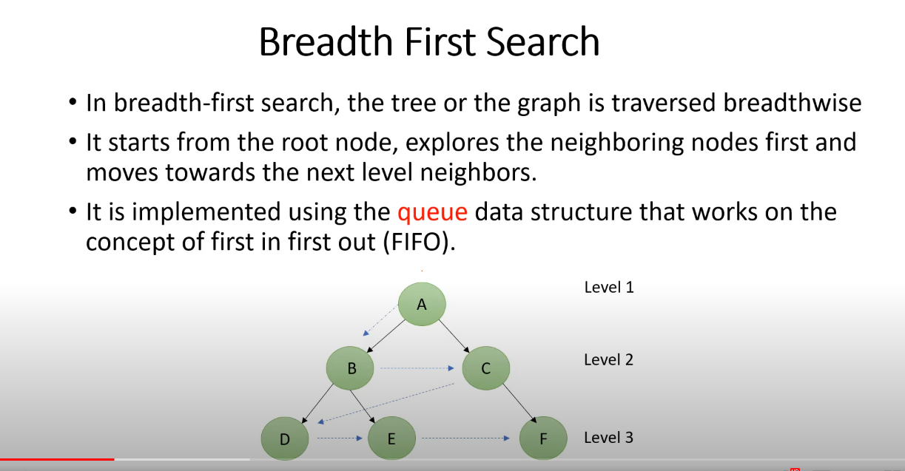

Slide 44
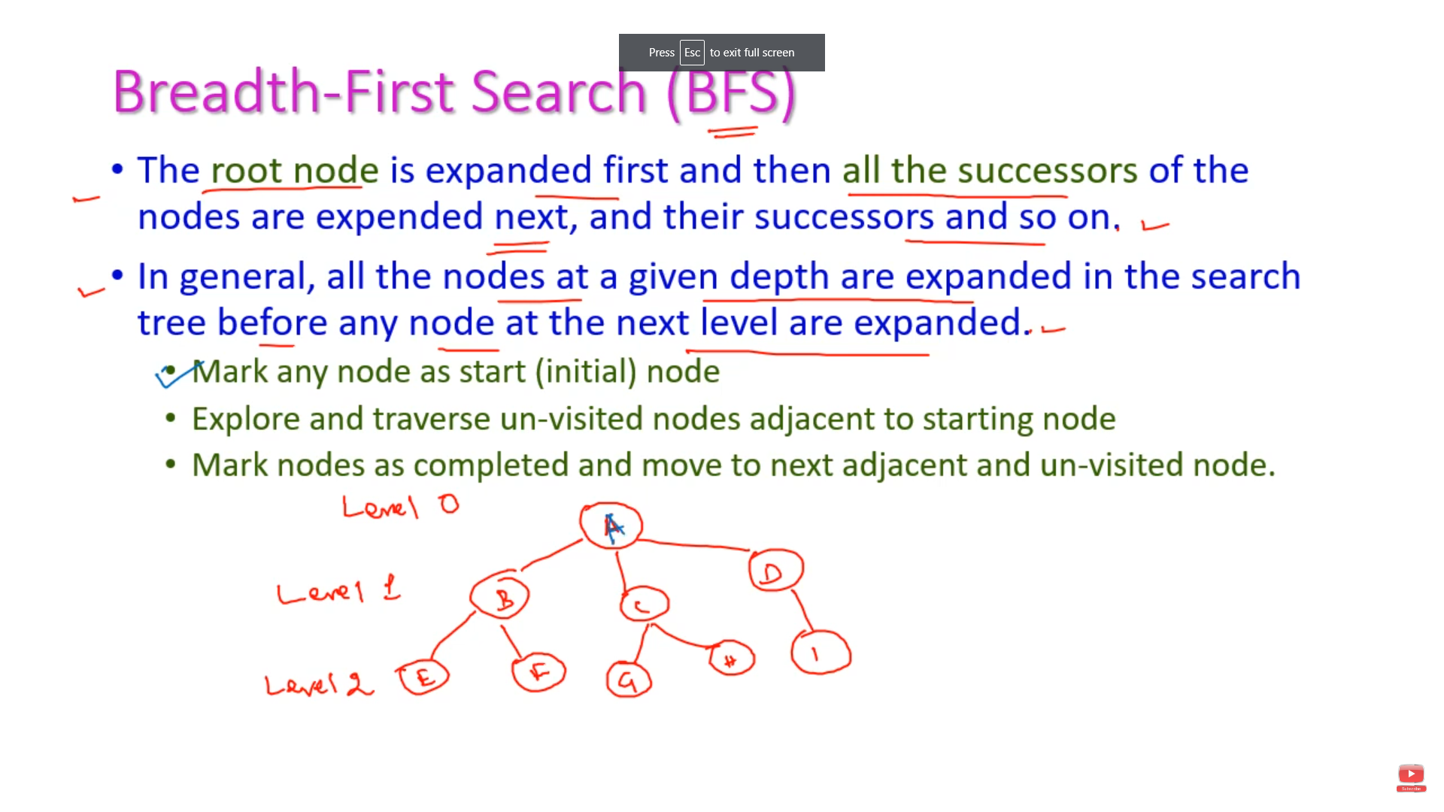

Slide 45
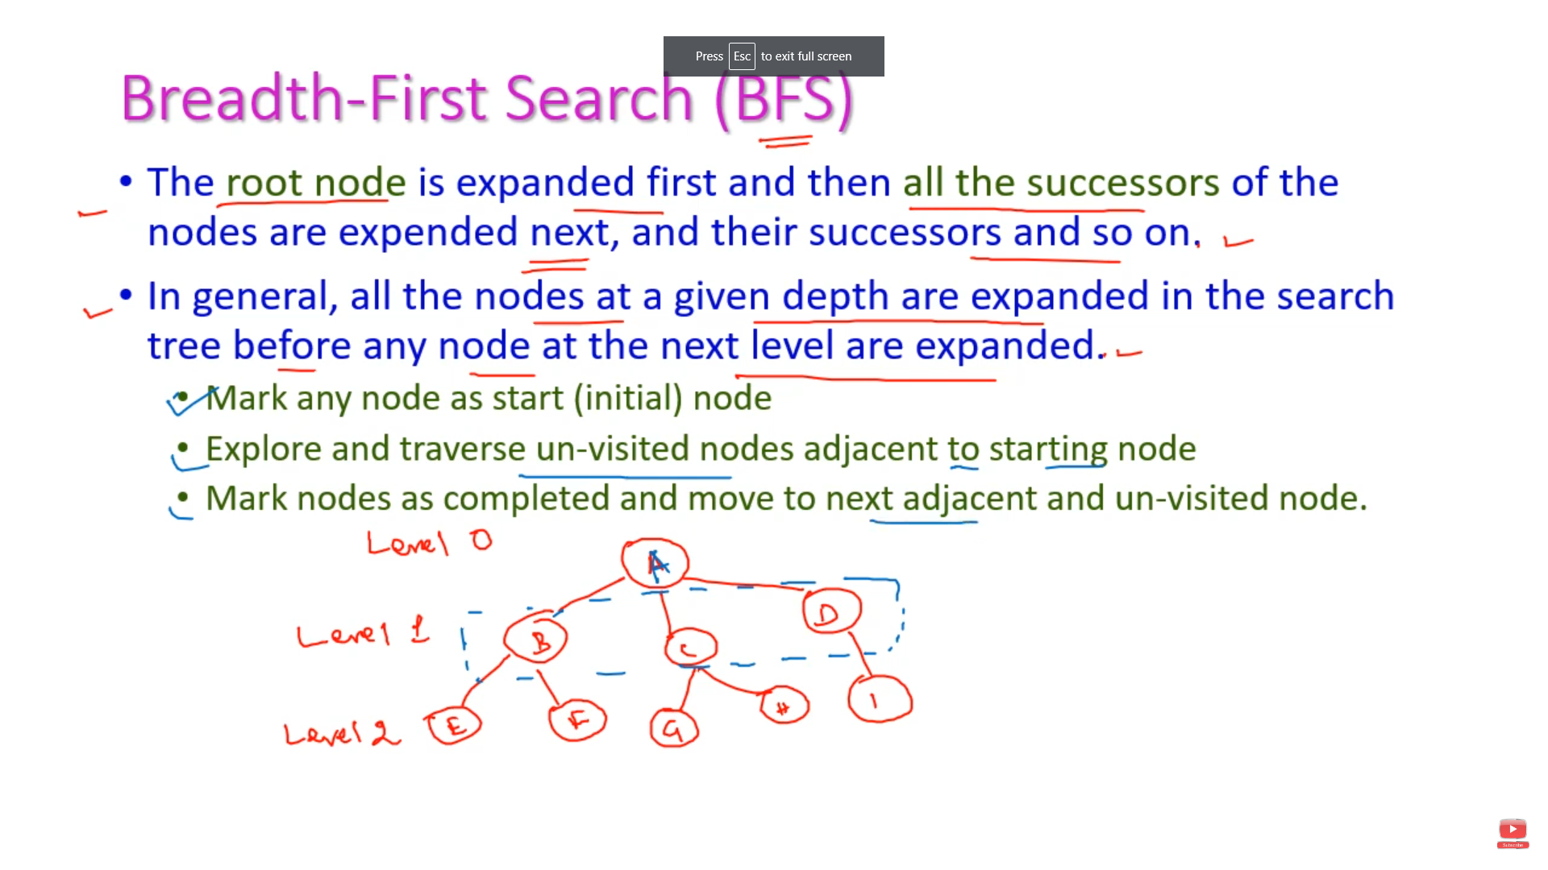

Slide 46
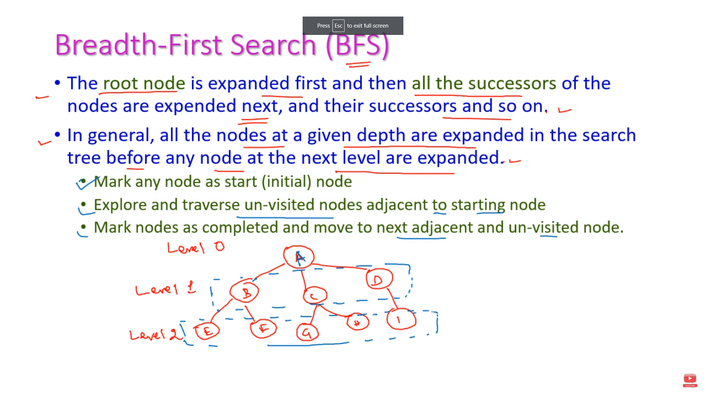

Slide 47
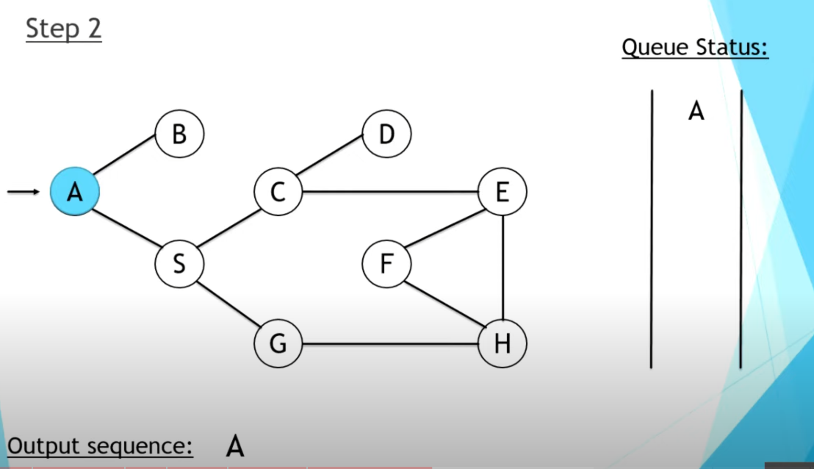

Slide 48
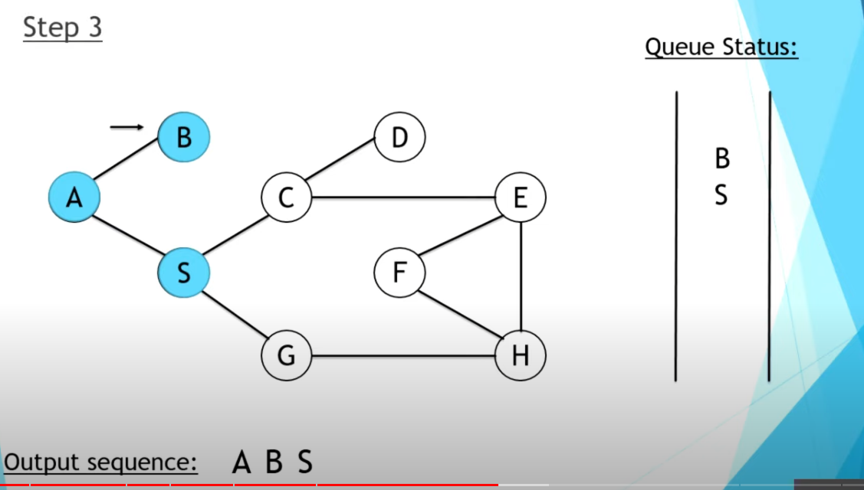

Slide 49
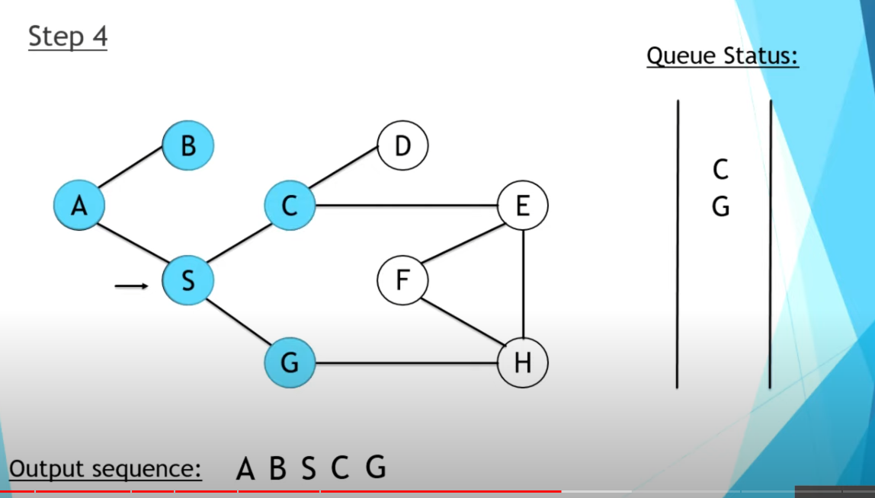

Slide 50
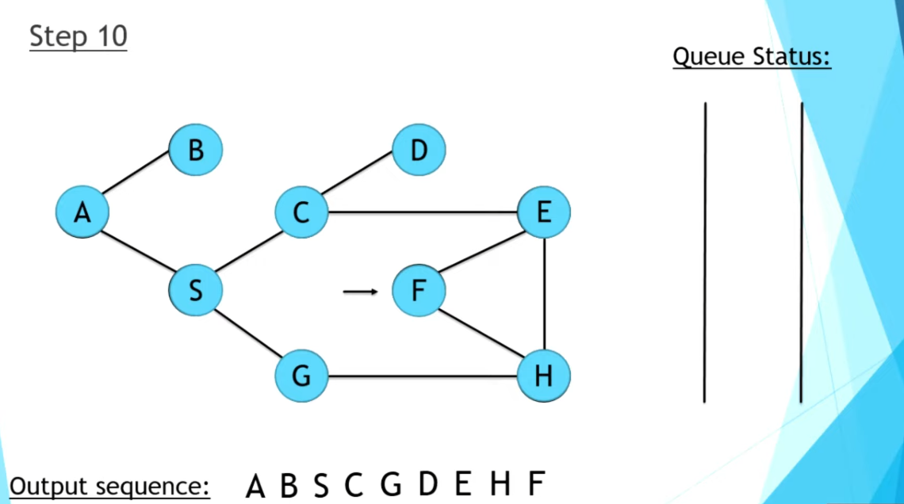
BFS

Slide 51
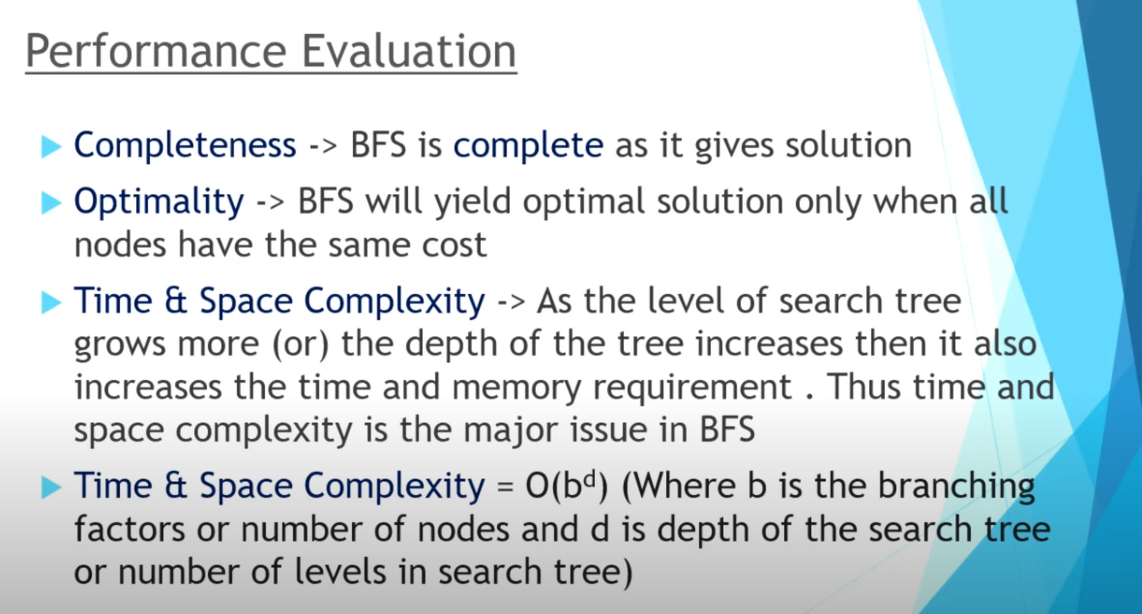
Performance

Slide 52
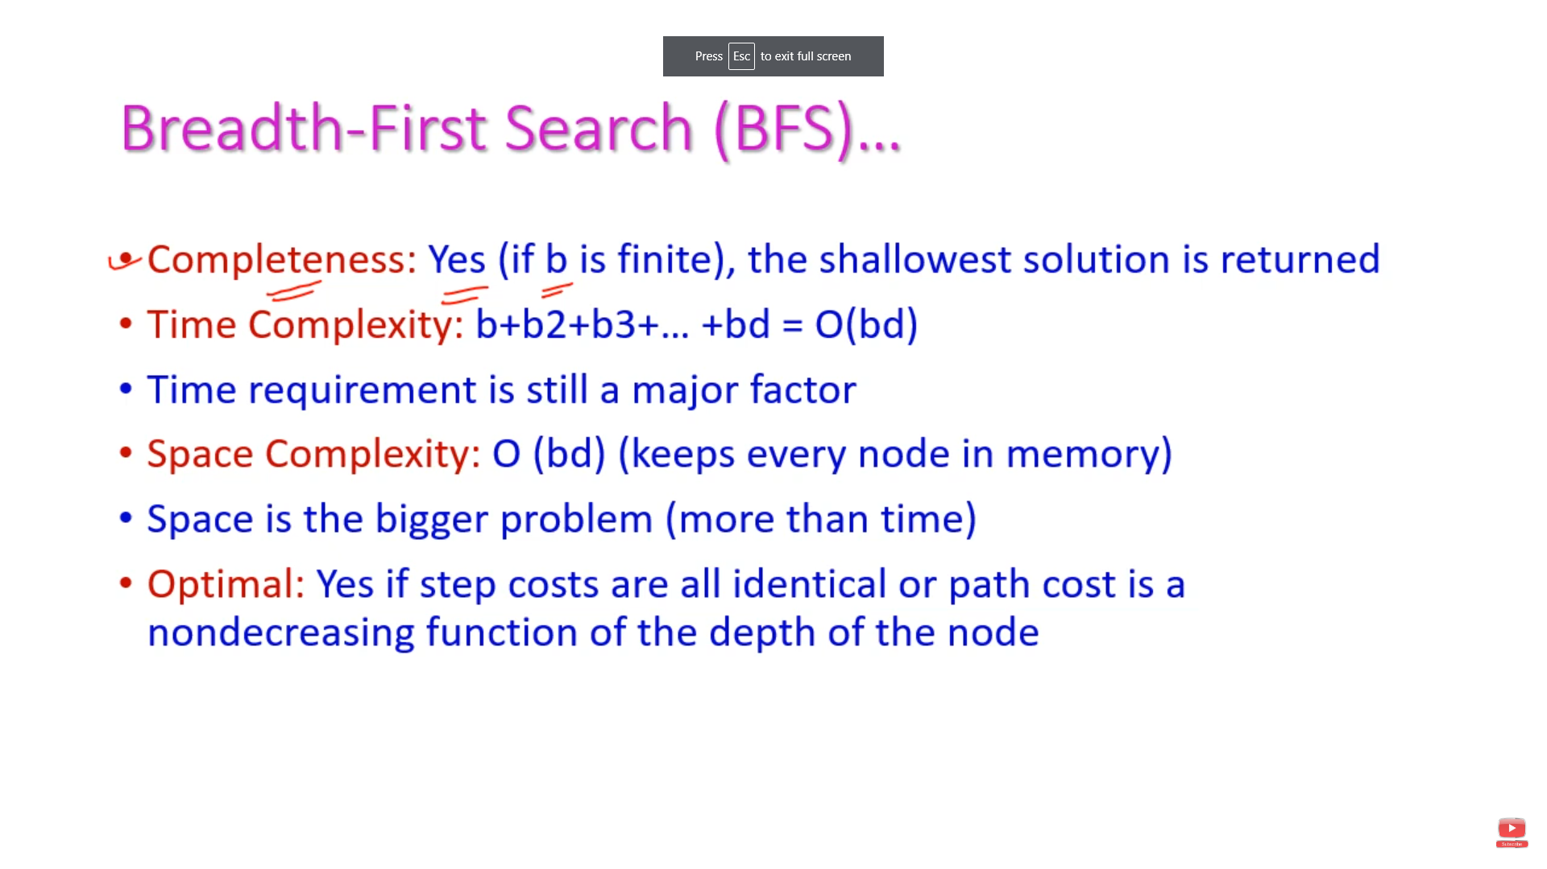

Slide 53
Breadth-First Strategy
New nodes are inserted at the end of FRINGE
1
2
3
FRINGE = (1)
4
5
6
7

Slide 54
Breadth-First Strategy
New nodes are inserted at the end of FRINGE
1
2
3
FRINGE = (2, 3)
4
5
6
7

Slide 55
Breadth-First Strategy
New nodes are inserted at the end of FRINGE
1
2
3
FRINGE = (3, 4, 5)
4
5
6
7

Slide 56
Breadth-First Strategy
New nodes are inserted at the end of FRINGE
1
2
3
FRINGE = (4, 5, 6, 7)
4
5
6
7

Slide 57
Properties of breadth-first search
Complete? Yes (if b is finite)
Time? 1+b+b²+b³+… +b^{d} = b(b^{d}-1) = O(b^{d+1})
Space? O(b^{d+1}) (keeps every node in memory)
Optimal? Yes (if cost = 1 per step)
Space is the bigger problem (more than time)

Slide 58
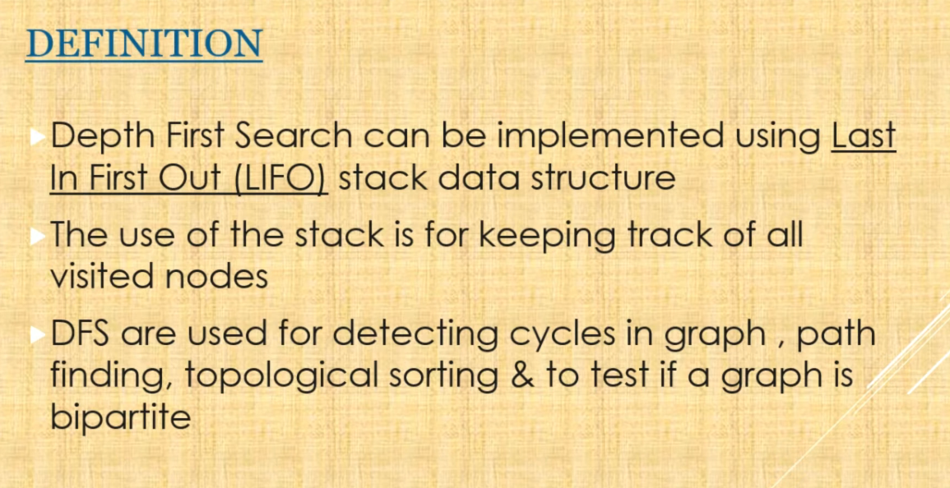
DFS

Slide 59
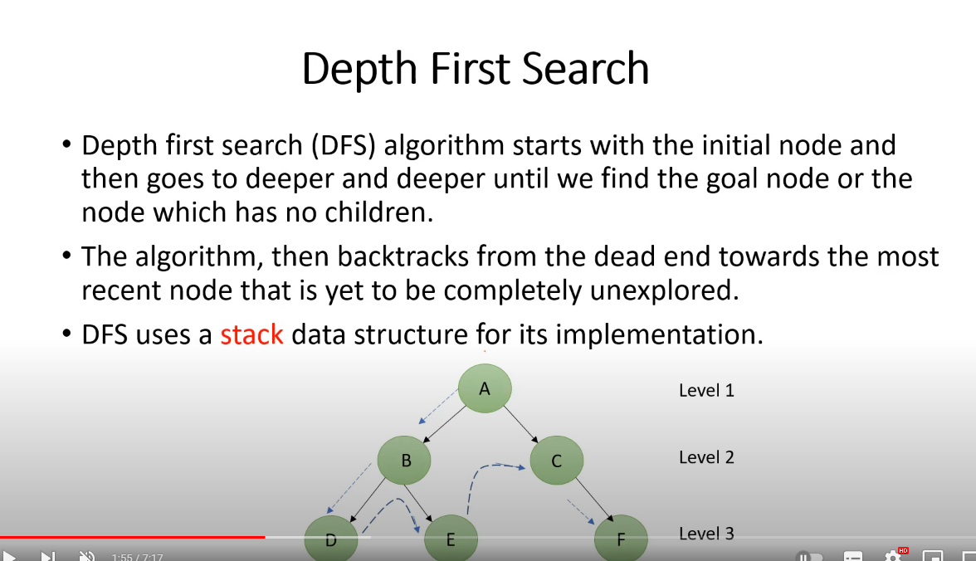

Slide 60
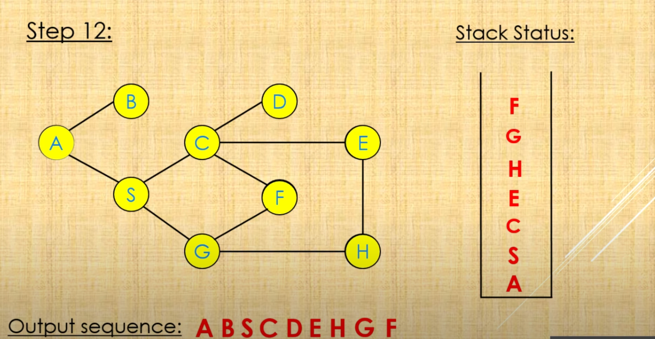

Slide 61
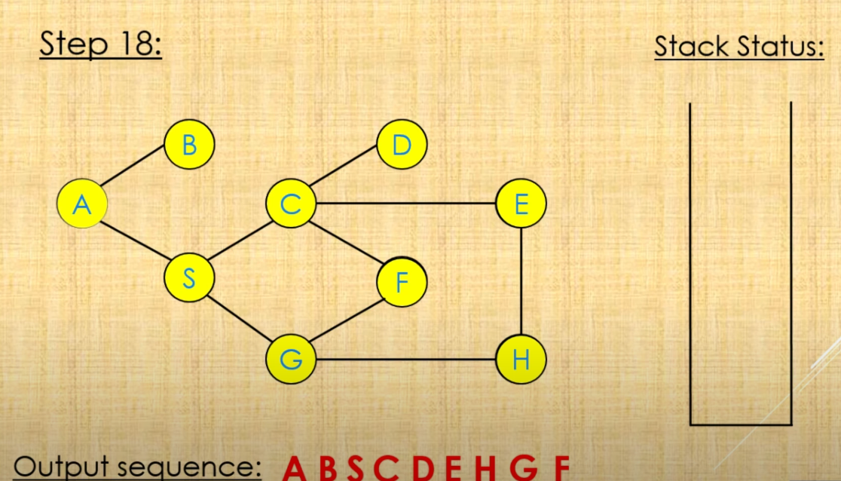

Slide 62
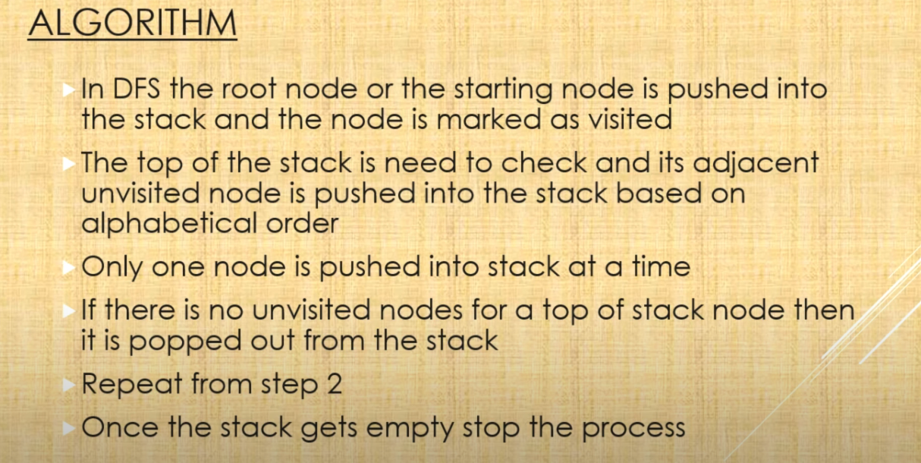

Slide 63
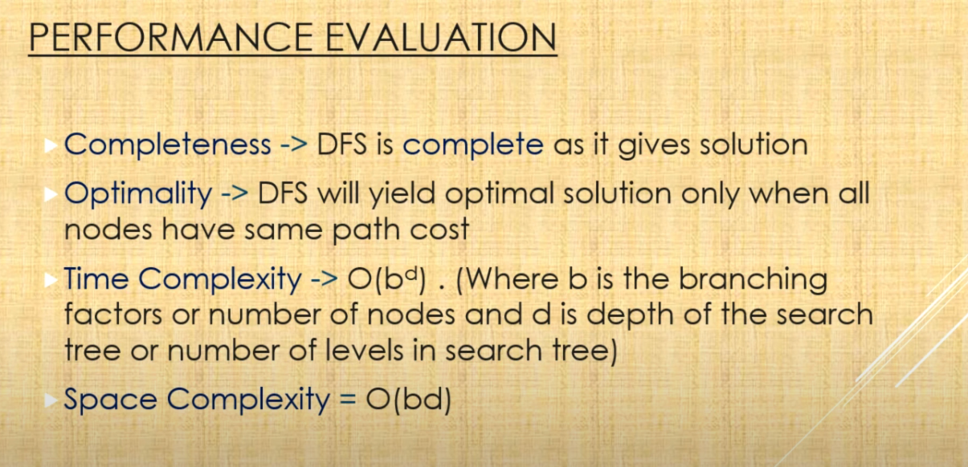

Slide 64
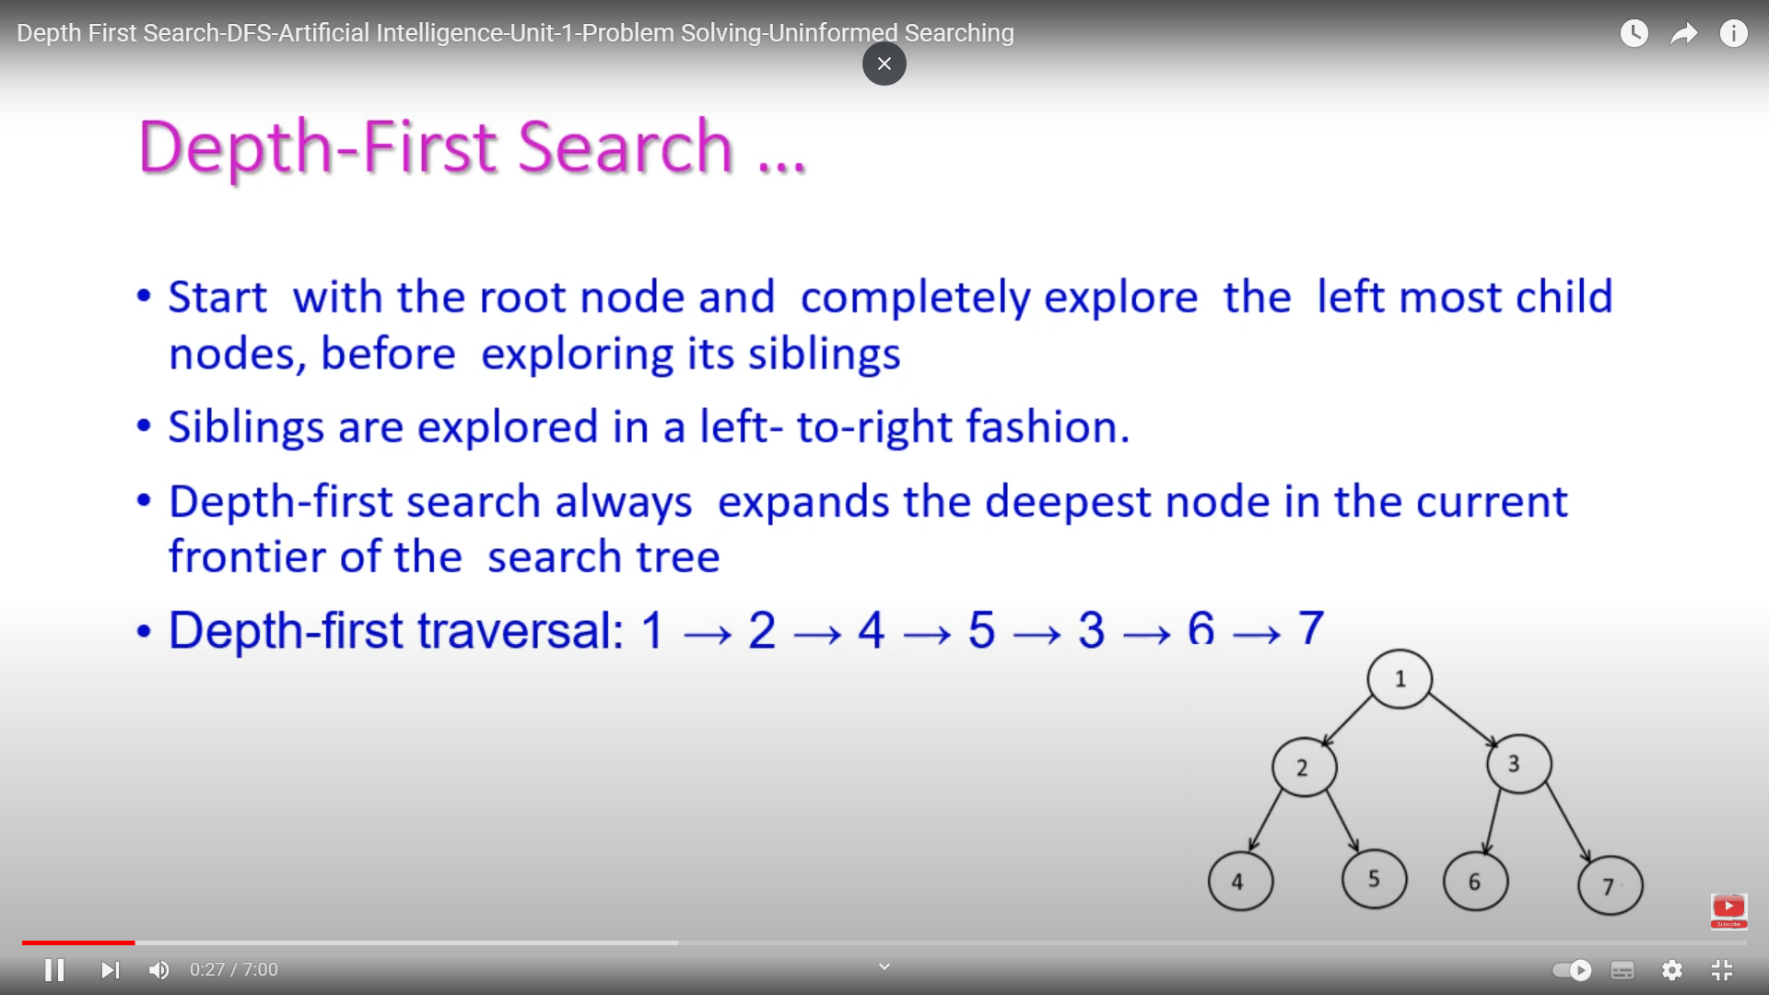

Slide 65
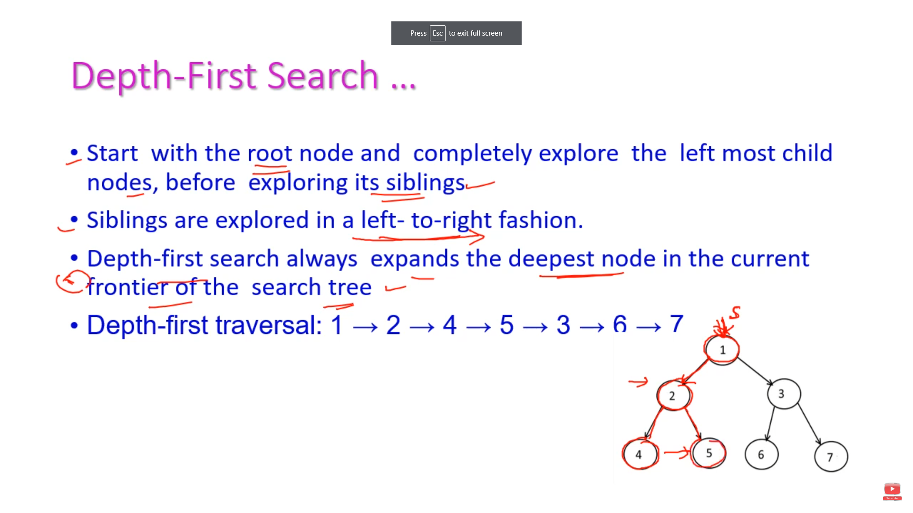

Slide 66
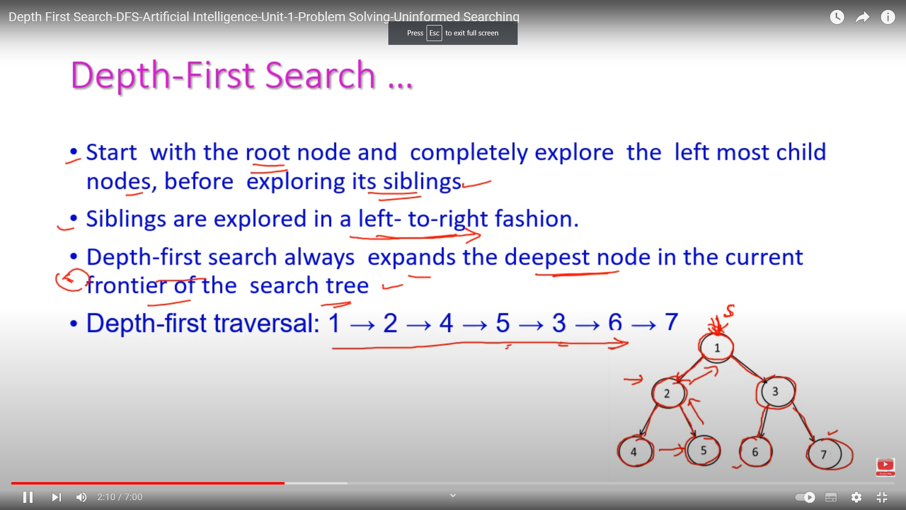

Slide 67
Depth-first search
Always expands one of the nodes at the deepest level of the tree
Only when the search hits a dead end
goes back and expands nodes at shallower levels
Dead end → leaf nodes but not the goal
Backtracking search
only one successor is generated on expansion
rather than all successors
fewer memory

Slide 68
Depth-first search (Analysis)
Not complete
because a path may be infinite or looping
then the path will never fail and go back try another option
Not optimal
it doesn't guarantee the best solution
It overcomes
the time and space complexities

Slide 69
Properties of depth-first search
Complete? No: fails in infinite-depth spaces, spaces with loops
Modify to avoid repeated states along path
→ complete in finite spaces
Time? O(b^{m}): terrible if m is much larger than d
but if solutions are dense, may be much faster than breadth-first
Space? O(bm), i.e., linear space!
Optimal? No

Slide 70
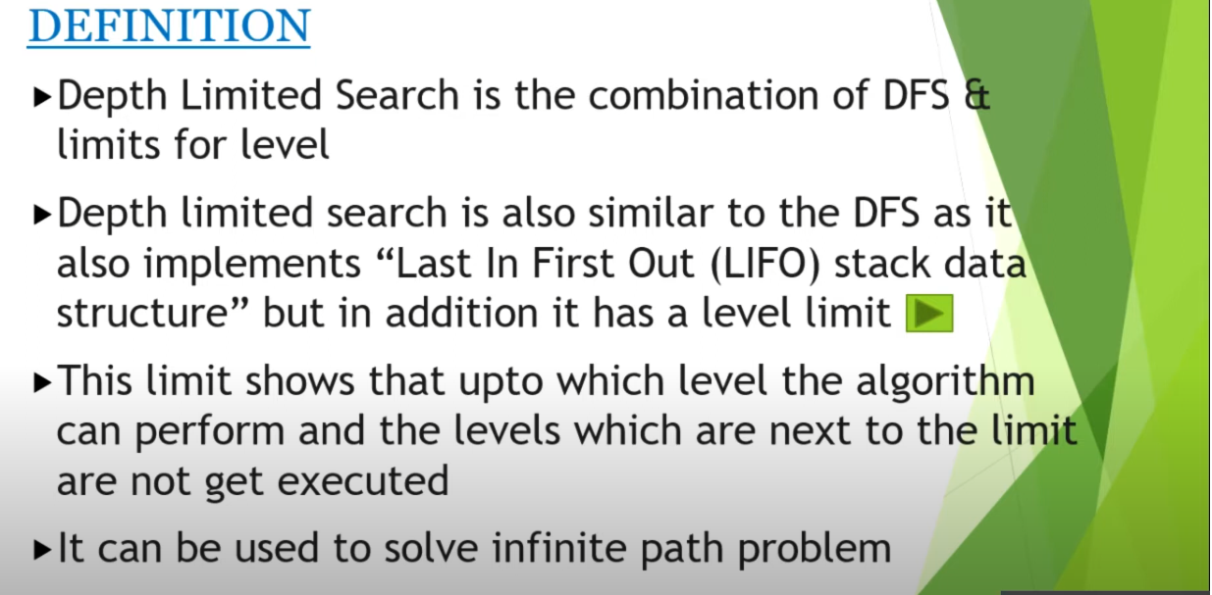
Depth-Limited Strategy

Slide 71
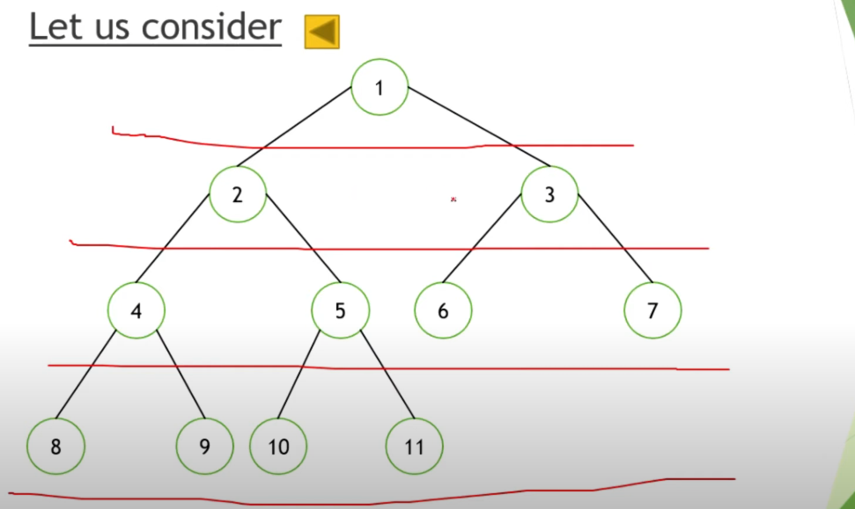

Slide 72
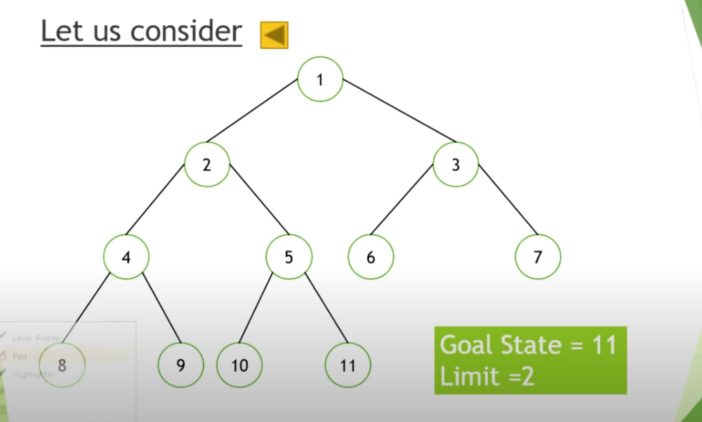

Slide 73
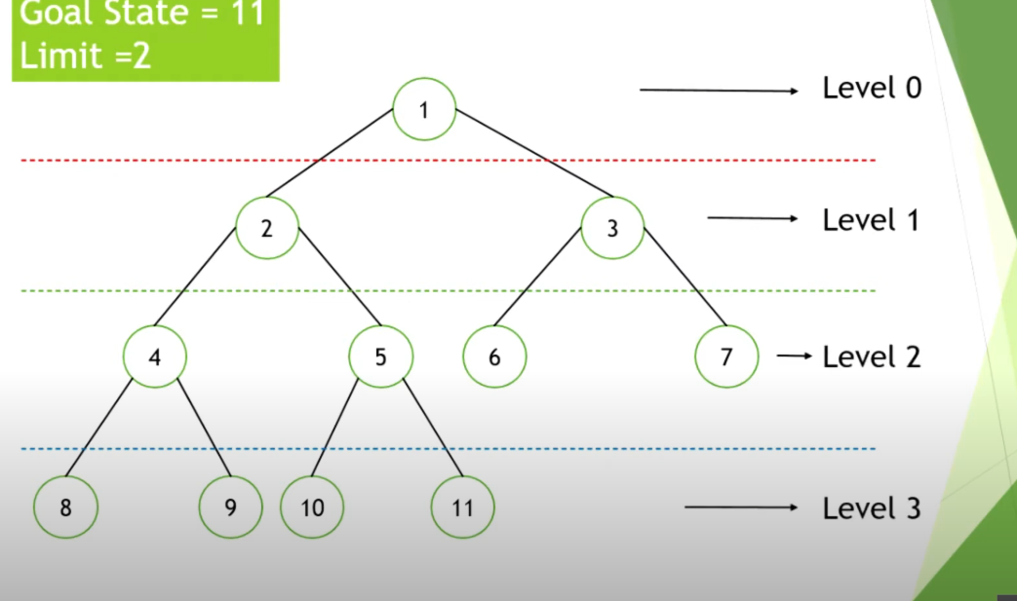

Slide 74
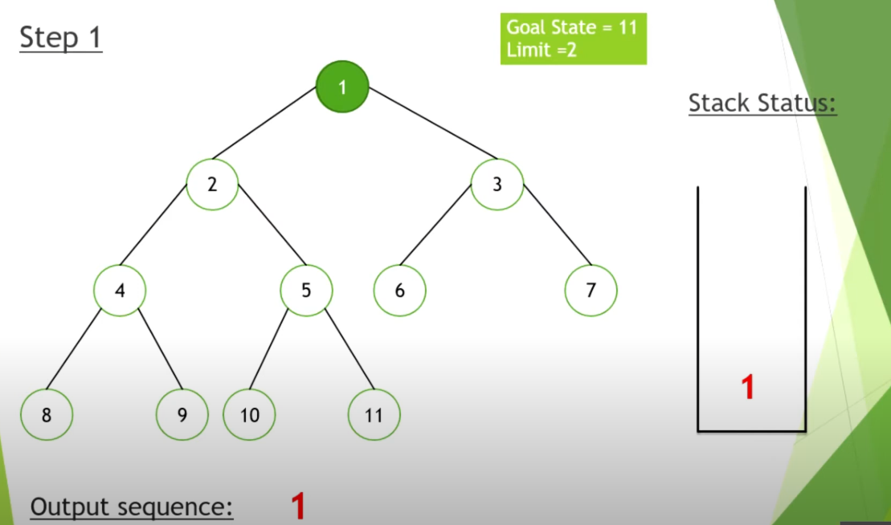

Slide 75
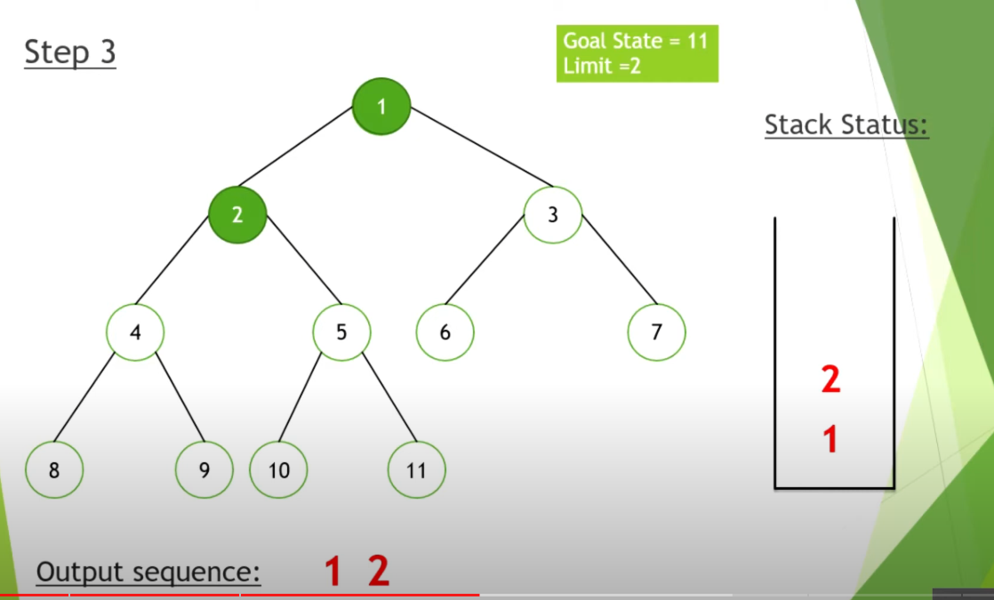

Slide 76
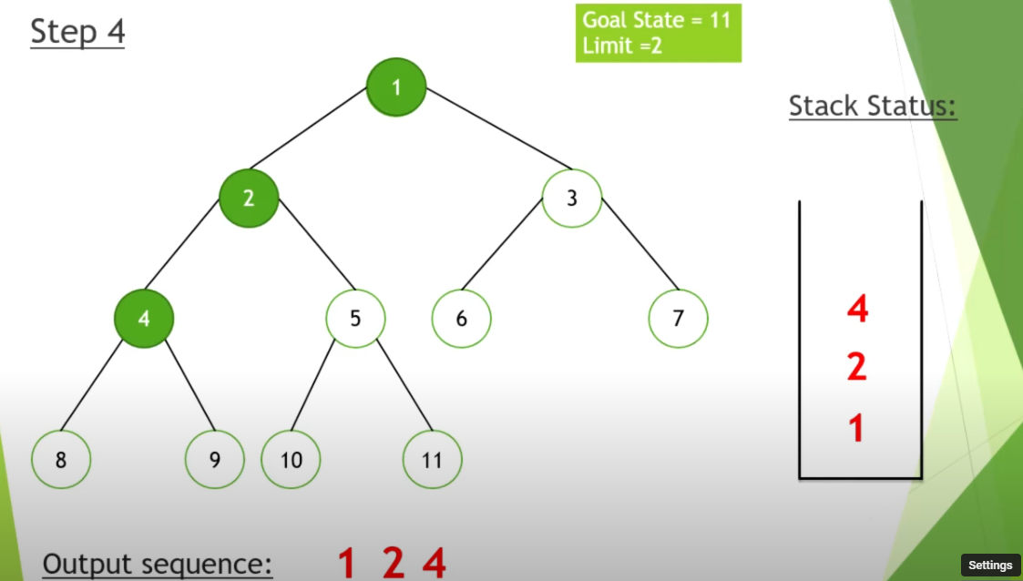

Slide 77
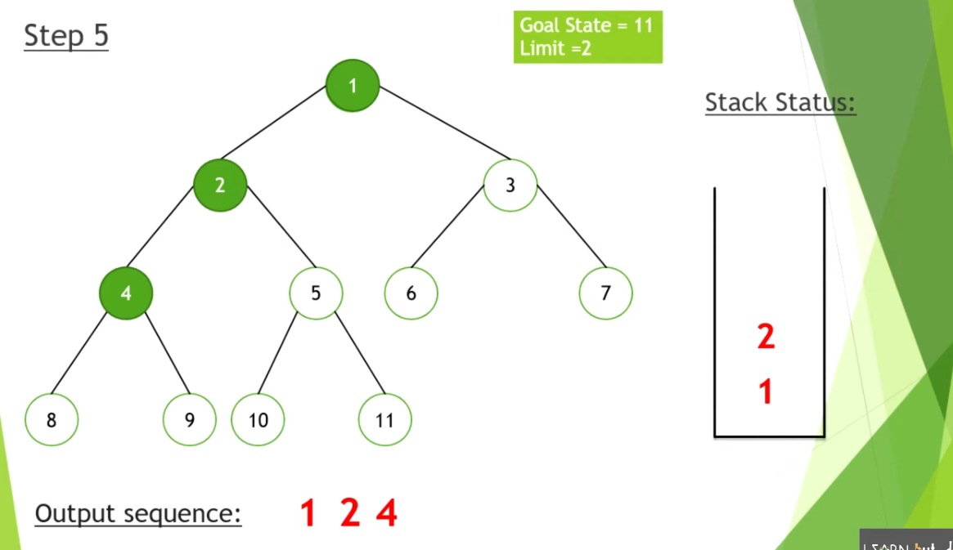

Slide 78
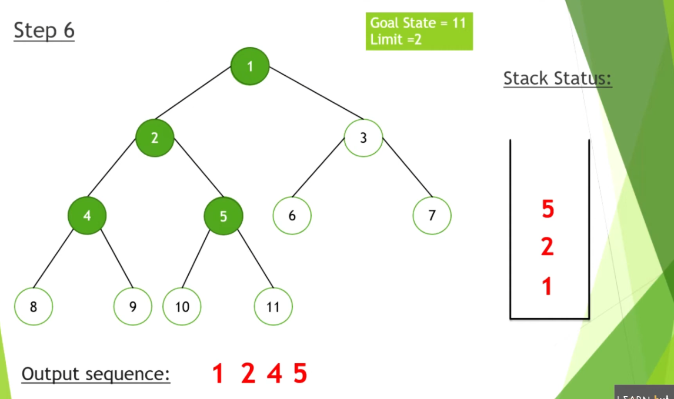

Slide 79
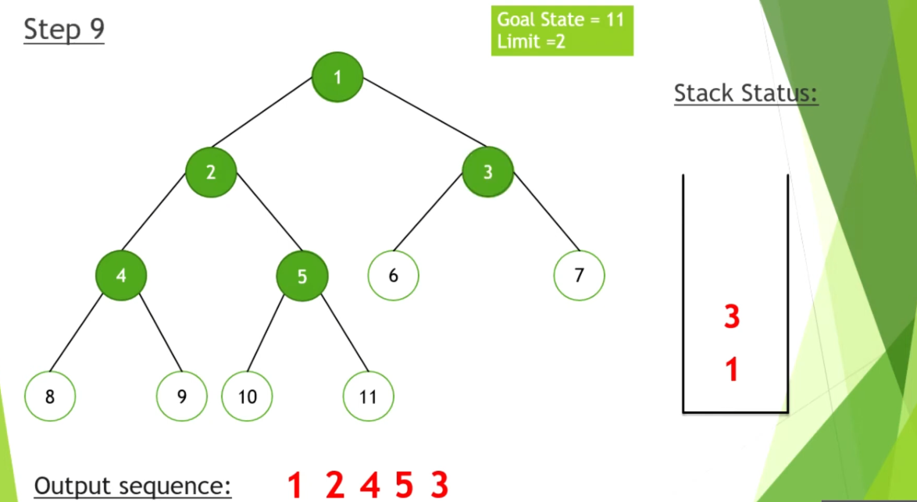

Slide 80
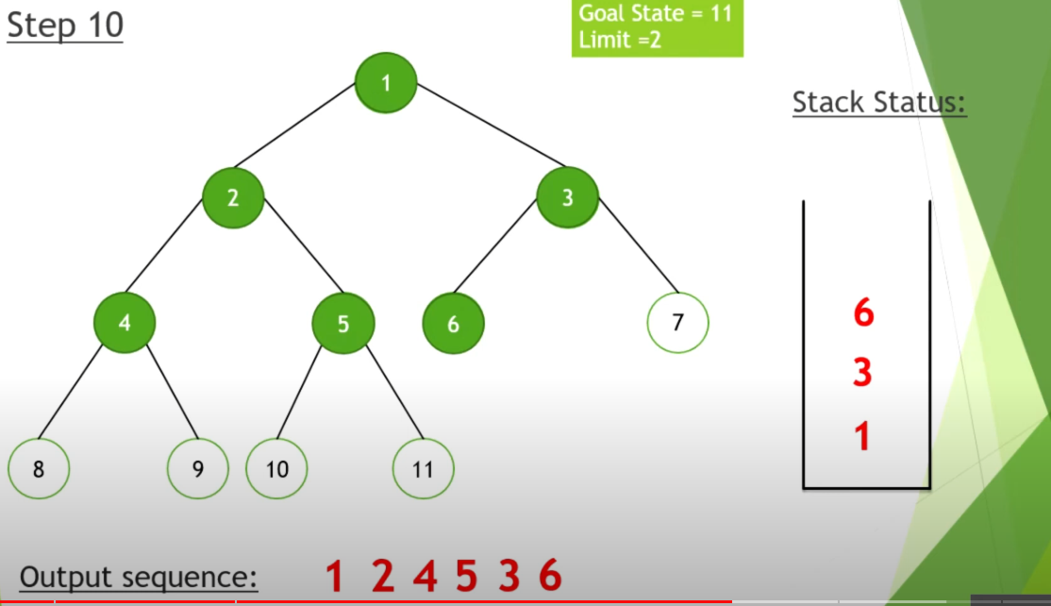

Slide 81
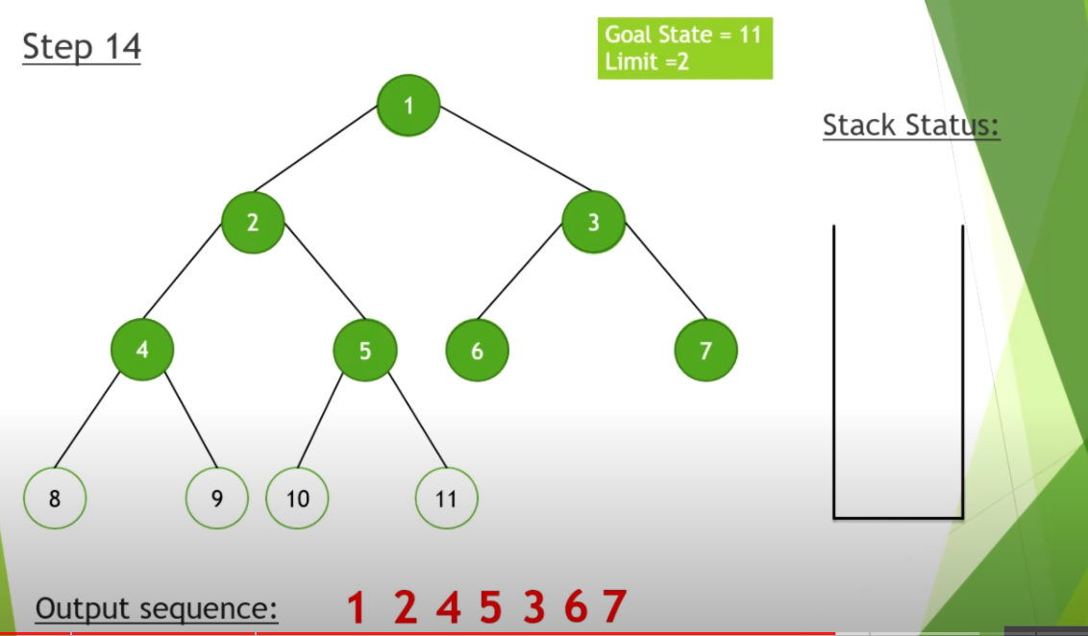

Slide 82
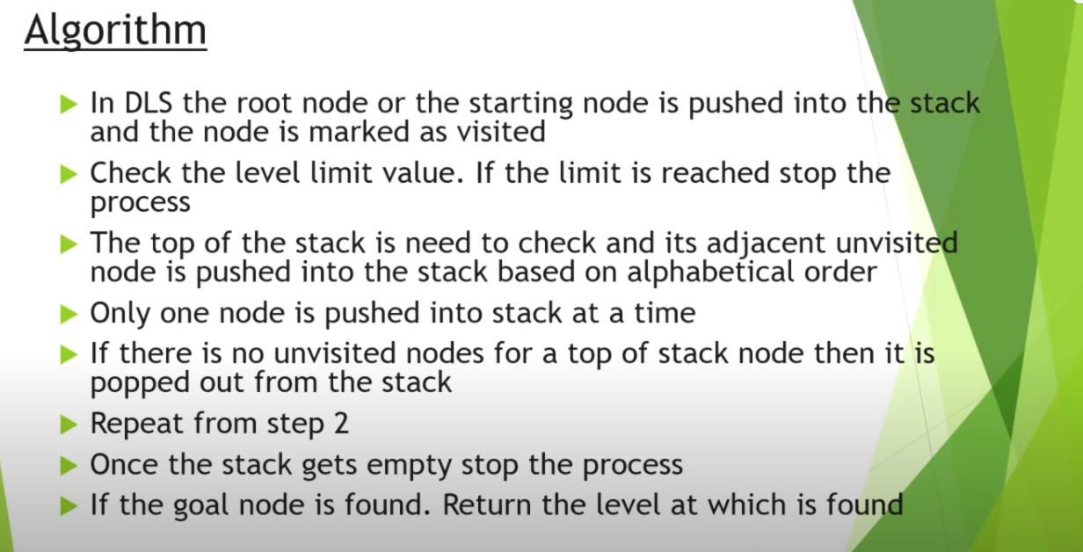

Slide 83
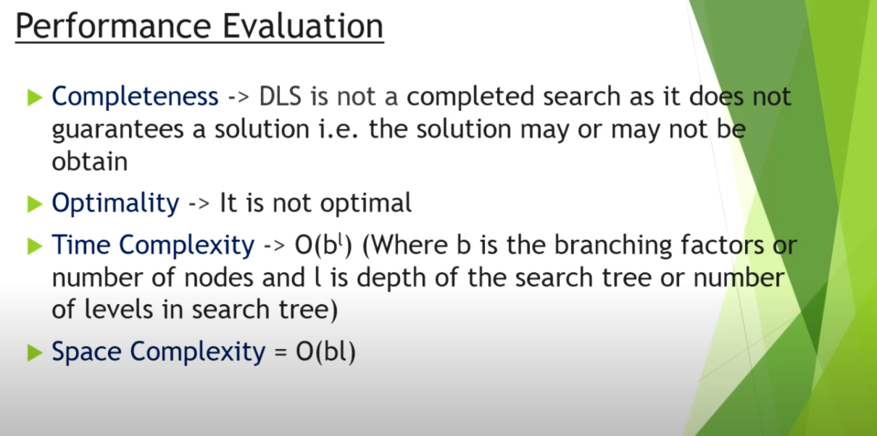

Slide 84
Depth-limited search
It is depth-first search
with a predefined maximum depth
However, it is usually not easy to define the suitable maximum depth
too small → no solution can be found
too large → the same problems are suffered from
Anyway the search is
complete
but still not optimal

Slide 85
Iterative deepening search
No choosing of the best depth limit
It tries all possible depth limits:
first 0, then 1, 2, and so on
combines the benefits of depth-first and breadth-first search

Slide 86
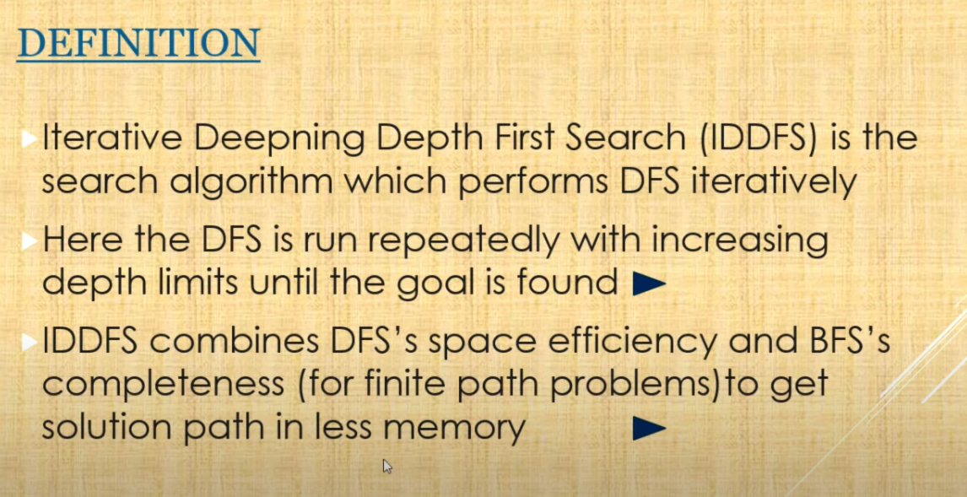

Slide 87
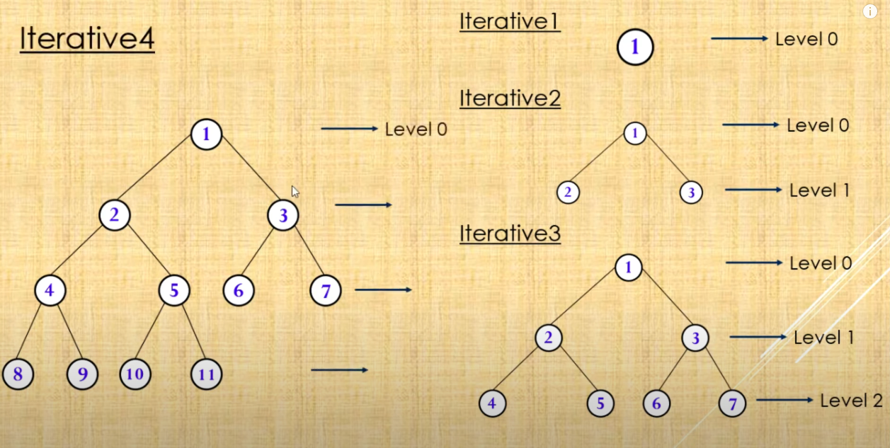

Slide 88
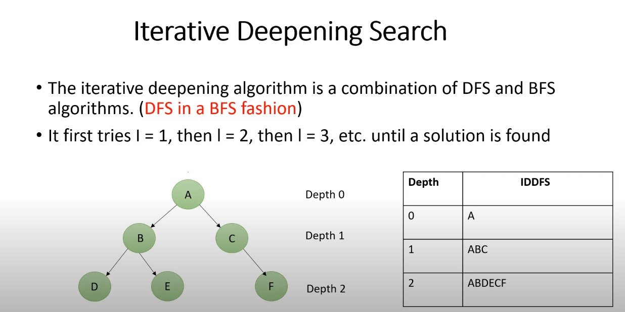

Slide 89
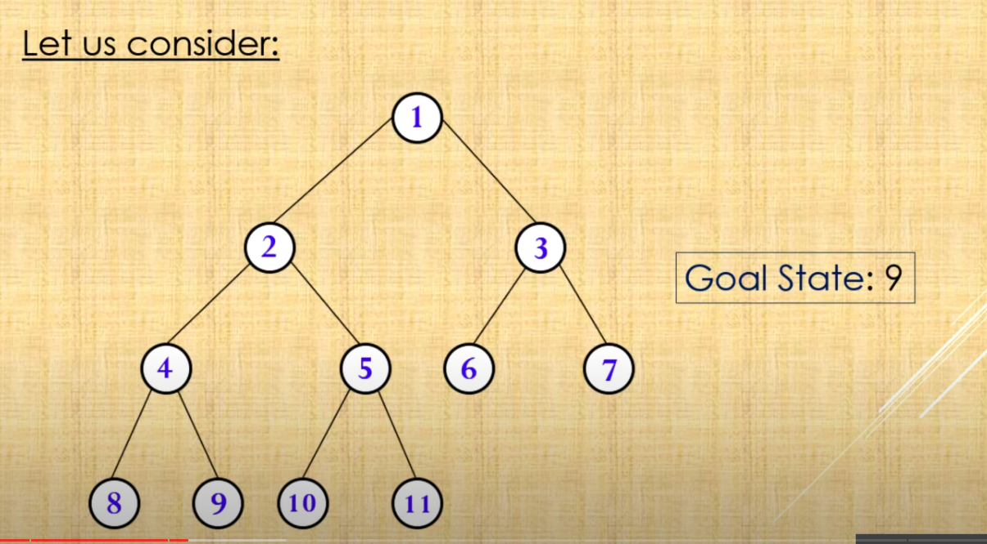

Slide 90
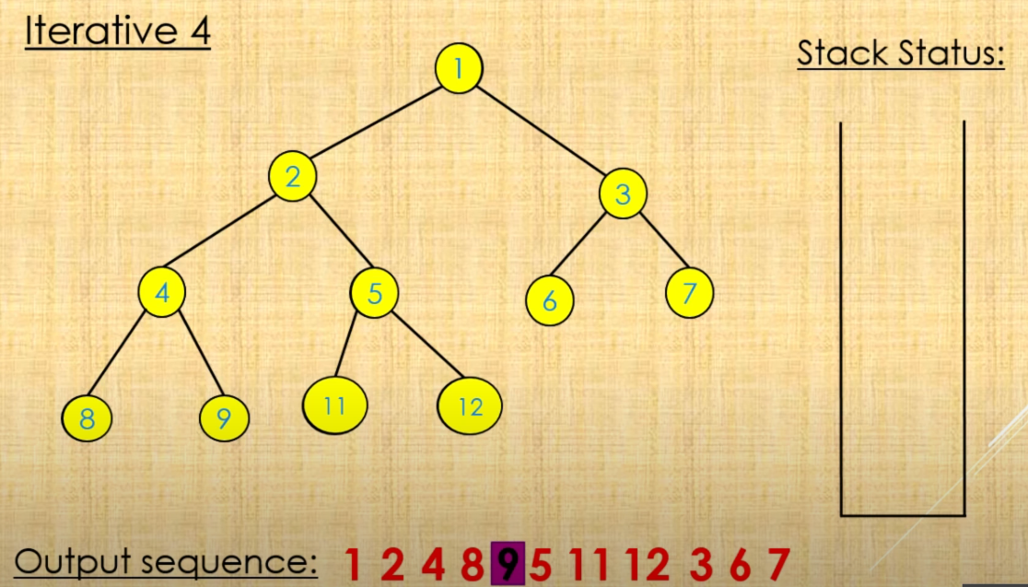

Slide 91


Slide 92


Slide 93

Bidirectional search

Slide 94


Slide 95


Slide 96


Slide 97


Slide 98


Slide 99


Slide 100

Uniform cost search

Slide 101


Slide 102


Slide 103


Slide 104


Slide 105


Slide 106


Slide 107


Slide 109


Slide 110
Informed Search

Slide 111
Traditional informed search strategies
Greedy Best first search
“Always chooses the successor node with the best f value” where f(n) = h(n)
We choose the one that is nearest to the final state among all possible choices
A* search
Best first search using an “admissible” heuristic function f that takes into account the current cost g
Always returns the optimal solution path

Slide 112
Informed Search Strategies
Greedy Search
eval-fn: f(n) = h(n)

Slide 113
A heuristic function
[dictionary]“A rule of thumb, simplification, or educated guess that reduces or limits the search for solutions in domains that are difficult and poorly understood.”
h(n) = estimated cost of the cheapest path from node n to goal node.
If n is goal then h(n)=0

Slide 114


Slide 115


Slide 116


Slide 117


Slide 118
Greedy best-first search
Tries to expand the node
closest to the goal
because it’s likely to lead to a solution quickly
Just evaluates the node n by
heuristic function: f(n) = h(n)
E.g., SLD – Straight Line Distance
h_{SLD}

Slide 119


Slide 120

Greedy best-first search
Goal is Bucharest
Initial state is Arad
h_{SLD} cannot be computed from the problem itself
only obtainable from some amount of experience

Slide 121


Slide 122
Greedy Search
Start
State | Heuristic: h(n)
A | 366
B | 374
C | 329
D | 244
E | 253
F | 178
G | 193
H | 98
I | 0
A
75
118
140
B
C
111
E
D
80
99
G
F
97
H
211
101
I
Goal
f(n) = h (n) = straight-line distance heuristic

Slide 123
Greedy Search: Tree Search
Start
A
75
118
[329]
140
[374]
B
C
[253]
E
80
99
[193]
[178]
G
F
[366]
A
211
[253]
I
[0]
E
Goal
Path cost(A-E-F-I) = 253 + 178 + 0 = 431
dist(A-E-F-I) = 140 + 99 + 211 = 450

Slide 124
Greedy best-first search
It is good ideally
but poor practically
since we cannot make sure a heuristic is good
Also, it just depends on estimates on future cost

Slide 125


Slide 126
A* search
The most well-known best-first search
evaluates nodes by combining
path cost g(n) and heuristic h(n)
f(n) = g(n) + h(n)
g(n) – cheapest known path
f(n) – cheapest estimated path
Minimizing the total path cost by
combining uniform-cost search
and greedy search

Slide 127


Slide 128
A* Search: h not admissible !
Start
State | Heuristic: h(n)
A | 366
B | 374
C | 329
D | 244
E | 253
F | 178
G | 193
H | 138
I | 0
A
75
118
140
B
C
111
E
D
80
99
G
F
97
H
211
101
I
f(n) = g(n) + h (n) – (H-I) Overestimated
g(n): is the exact cost to reach node n from the initial state.
Goal

Slide 129
A* Search: Tree Search
A
Start
118
75
140
E
[393]
B
[449]
[447]
C
80
99
[473]
[413]
G
F
[417]
D
97
[455]
Goal
H
I
[450]

Slide 130


Slide 131


